Slide 1
Introduction to Dell SonicWALL WAN Acceleration
Matt Dieckman/Scott Grebe
Product Line Manager
Notes:
Welcome to the Dell SonicWALL WAN Acceleration product overview. In this presentation we’ll cover the following topics:
What does WAN Acceleration do?
Dell SonicWALL’s approach to WAN Acceleration
Dell SonicWALL’s WAN Acceleration solution – the WXA Series
What can and can’t be accelerated
Visualizing the benefits of WAN Acceleration
And finally, we’ll look at the WXA Series feature and technical specs

Slide 2
What Does WAN Acceleration Do?
WAN Acceleration technology helps to…
Improve performance of business applications
Optimize response times for critical applications
Reduce bandwidth consumption
Reduce associated bandwidth costs
…makes the network appear faster!
Notes:
We’ll begin with a look at what WAN Acceleration does.
As a technology, WAN Acceleration provides some significant benefits. These include:
Improving the performance of business-critical applications
Optimizing response times for these applications. In the next few slides we’ll talk more about the different business applications that can be accelerated and how they are accelerated
Reducing the bandwidth that network users consume
Finally, lowering consumption leads to a reduction in bandwidth costs. Why pay for more bandwidth when a solution exists to help you better utilize the bandwidth you already have?
When you put these all together, you have a network that’s not only more efficient, it’s also faster.

Slide 3
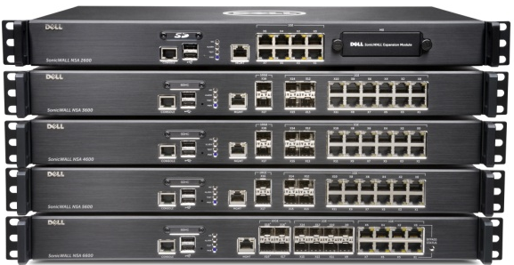
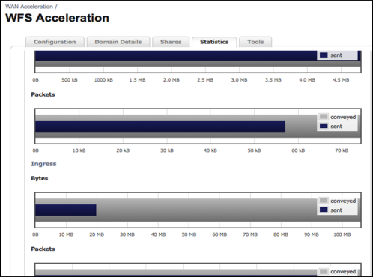
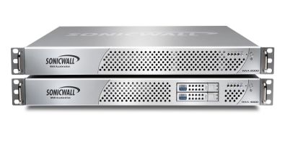
The Dell SonicWALL Approach
Dell SonicWALL Next-Generation Firewall
Traffic Shaping – allow “Good Traffic”
  Ensure “Good Traffic” composition with Application Intelligence and Control
  Block unwanted traffic
  Utilize bandwidth effectively
Dell SonicWALL WXA Solution
Traffic Acceleration – accelerate the traffic
  HTTP web caching
  Accelerate the “Good” traffic between offices
    Traffic de-duplication
    Windows File Share caching
    Protocol optimization
    Compression
Notes:
Dell SonicWALL has its own approach to WAN Acceleration. Let’s take a look.
We’ll start with a discussion of two key technologies at the core of Dell SonicWALL’s WAN Acceleration approach: Traffic Shaping and Traffic Acceleration.
Traffic Shaping is a means of ensuring the traffic that goes through your network is “good” or “business-critical” and not “bad” or non-essential and time-wasting. Dell SonicWALL Next-Generation Firewalls provide the tools that enable IT administrators to determine and categorize good traffic from bad, and then block unwanted traffic while prioritizing the good. Doing so helps them utilize the bandwidth that they have more effectively. We’ll talk more about this shortly.
The other technology that Dell SonicWALL WAN Acceleration appliances utilize is Traffic Acceleration which consists of three components. The first of these is Traffic, or File, De-duplication. Here, the data that makes up a file is broken down into sequences where the commonly-seen, or “duplicate,” sequences are replaced with a token that the remote end recognizes and uses to re-assemble the message. This decreases the amount of data that needs to be sent across the link. The second is Windows File Sharing acceleration, which helps improve response times while decreasing the amount of data transferred when downloading or accessing files from a shared drive. And finally, Protocol Optimization provides LAN-like application performance for users accessing resources over the WAN by decreasing the latency and chattiness presented by inefficient protocols or application communication.

Slide 4
Traffic Shaping – Get “Good” Traffic
WAN Acceleration Step 1
Bandwidth manage and control applications
  Dell SonicWALL Application Intelligence, Control and Visualization
  4,100+ Application signatures
  Identify Applications
    Prioritize important traffic
    Block or restrict unimportant traffic
Goal:
“Allow Good Traffic” at the gateway with Application Intelligence and Control
Notes:
Now we’ll break these into two steps. The first step in WAN Acceleration – Traffic Shaping - can be achieved using Dell SonicWALL Application Intelligence, Control and Visualization which is available on Dell SonicWALL Next-Generation Firewalls. Application Intelligence, Control and Visualization enables IT administrators to indentify and categorize applications. Not only do you have the ability to identify the applications being used on your network, you also have control over whether or not the applications can be used, who can use them, when they can be used and how much bandwidth you want to allocate to the applications.

Slide 5
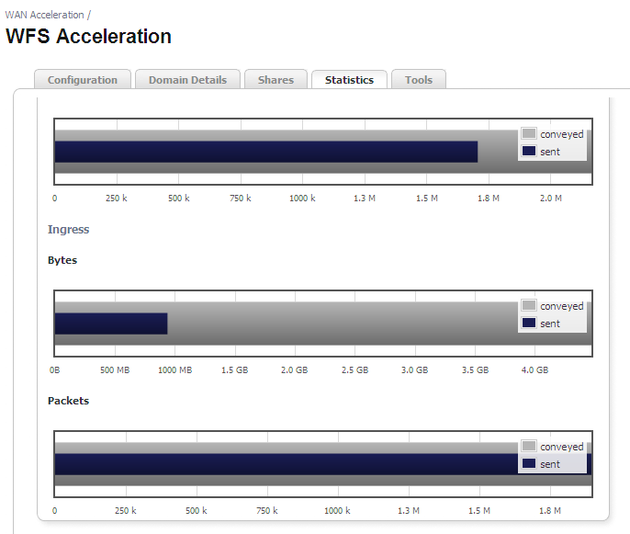
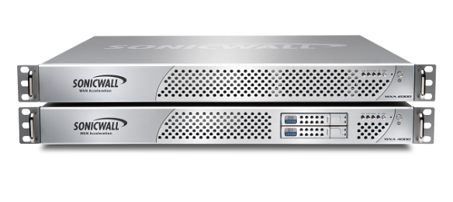
“Good Traffic” Acceleration
WAN Acceleration Step 2
Extremely effective for office-to-office:
  Email, PowerPoint, Excel spreadsheets,
  Word docs, PDFs
  Web apps, collaboration sites
  Files between 20Kb-100’s of MB+
  Small localized changes
Also for Internet-based content:
  Web content, videos, etc,
Benefits (for “Good Traffic”)
  Eliminate redundant traffic
  Increase responsiveness
  Improve user experience
Notes:
The second step in WAN Acceleration is the acceleration of “good” traffic. Unlike Traffic Shaping which happens on the firewall, Traffic Acceleration is handled by the WAN Acceleration solution. Traffic Acceleration works very well on many of the applications you use on a daily basis such as email, Microsoft Office apps including Word, PowerPoint and Excel, PDFs, file sharing sites and Web 2.0 apps. It doesn’t matter if the file size is small or large. Traffic Acceleration is more effective if the changes made to the file are smaller, but this is something you can monitor in the appliance’s local management interface which you can see to the right.
So how can a WAN Acceleration solution from Dell SonicWALL help customers? It’s simple. Reducing and even eliminating redundant traffic going between remote or branch office networks decreases latency, which speeds up responsiveness, both of which improve the experience of customers’ employees. Not only that, it enables them to be more productive.

Slide 6
Dell SonicWALL WAN Acceleration Overview
The Dell SonicWALL WXA Series
Notes:
So far we’ve talked about WAN Acceleration as a technology. Now let’s take a look at the WXA Series, Dell SonicWALL’s WAN Acceleration solution.

Slide 7

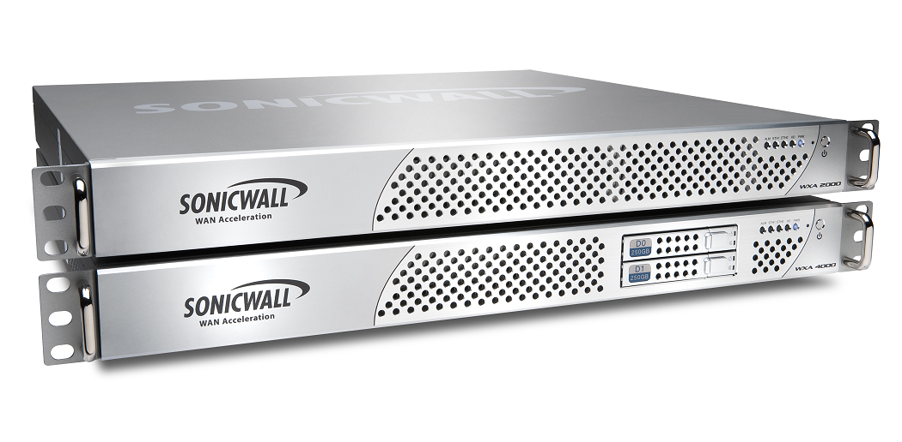

Dell SonicWALL WXA Series
WXA 500 software
WXA 6000 software
WXA 2000
WXA 4000
WXA 5000
Notes:
You already know Dell SonicWALL is a leading provider of Next-Generation Firewalls for businesses of all sizes. However you may not be aware that we have a portfolio of powerful, yet affordable, WAN Acceleration solutions called the WXA Series. The WXA Series is available in several delivery models to meet customers’ needs, including the WXA 500 Live CD, WXA 2000 and WXA 4000 hardware appliances, as well as the WXA 5000 Virtual Appliance. Unlike standalone WAN acceleration products, Dell SonicWALL WXA solutions are integrated add-ons to Dell SonicWALL Next-Generation Firewalls so they’re easy to deploy and manage.

Slide 8
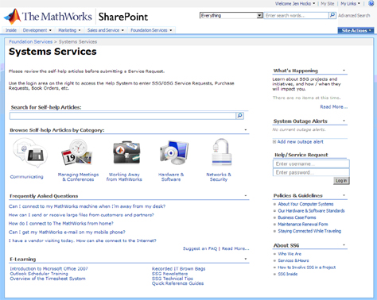
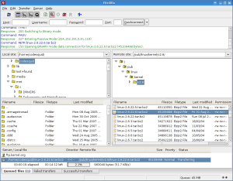
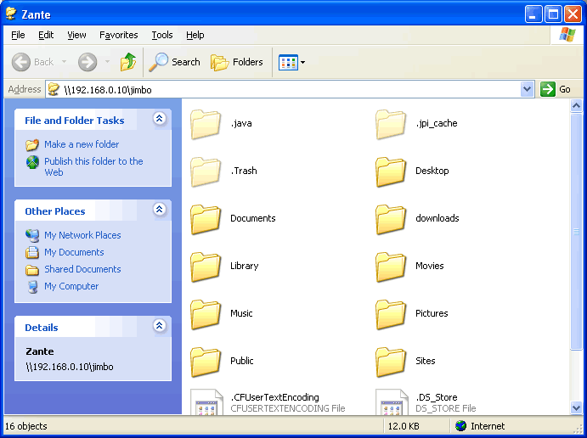
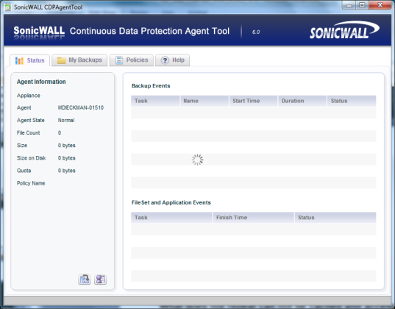
What Applications Can be Accelerated?
Internal web applications
FTP transfers
Windows File Sharing resources
SharePoint
Database apps
Backup and Recovery
(client-to-appliance CDP)
Database replication
and more…
Notes:
So which applications can the WXA Series accelerate?
The answer is, the WXA Series can accelerate many of the essential applications businesses use every day. Here are just a few:
Internal web applications [CLICK]
File transfers over FTP [CLICK]
Windows File Sharing [CLICK]
SharePoint
Database applications
Backup and Recovery from a client to a SonicWALL CDP appliance [CLICK]
Database replications
As I said, these are just a few.

Slide 9
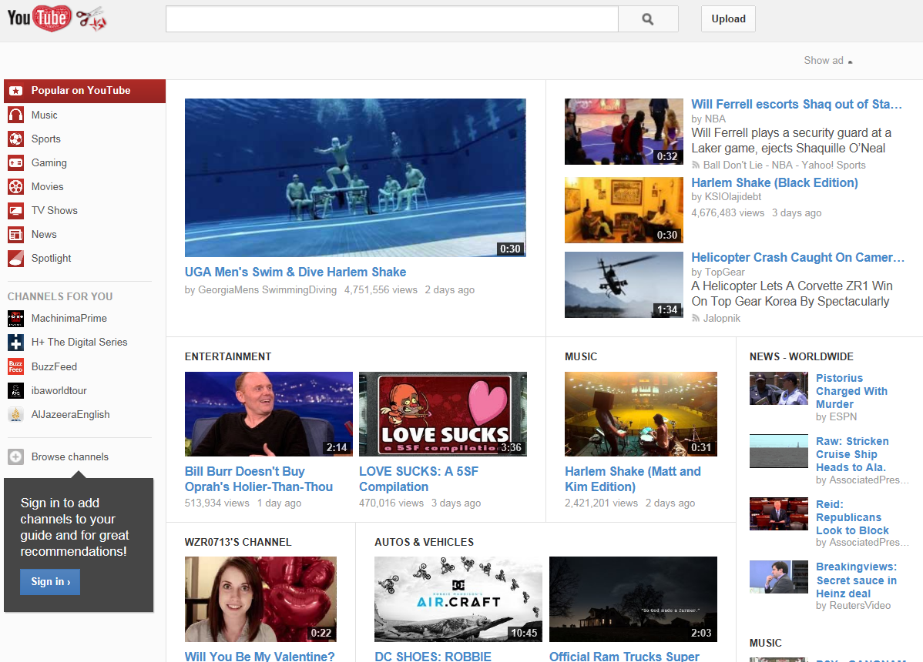
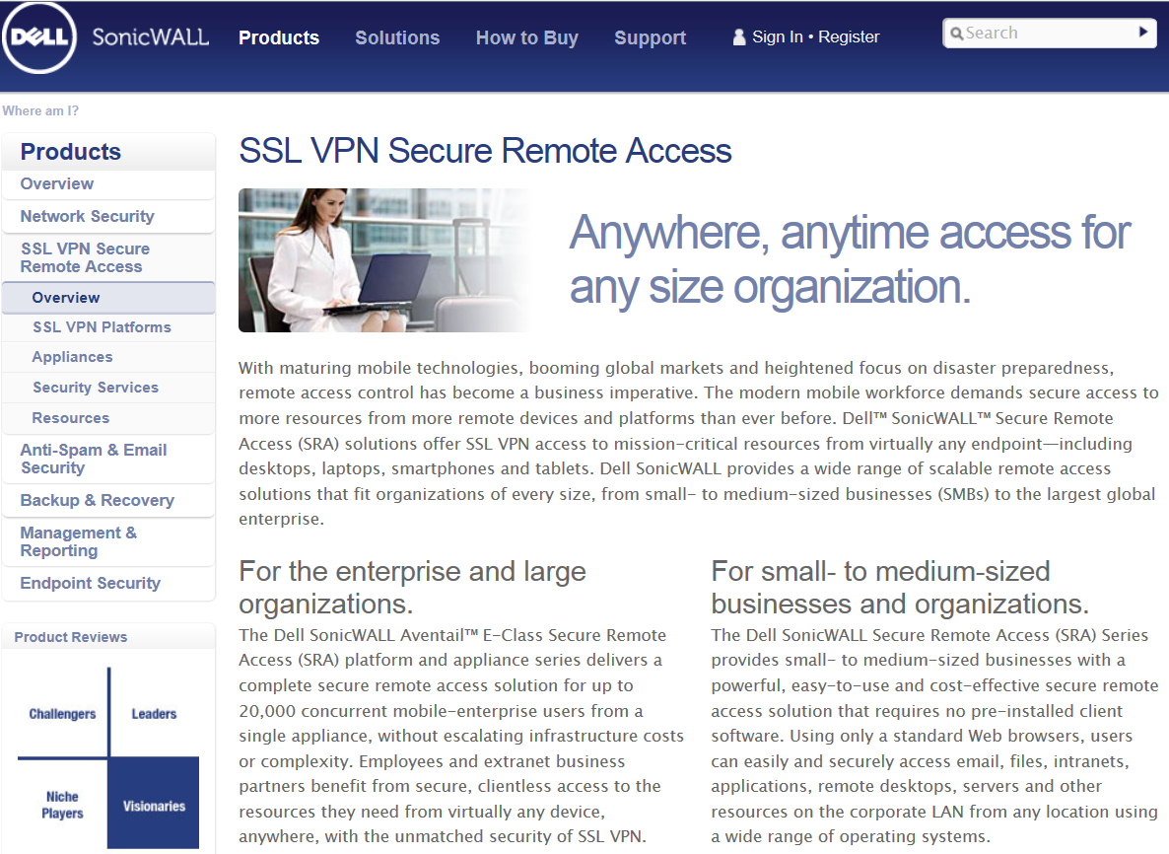
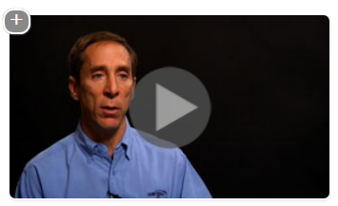
Internet Content That Can be Cached
YouTube videos
Corporate videos
Web sites
Other web-based content
Notes:
The following are applications in which the WXA series can accelerate. This is not a complete list, but is a well-known list of applications that can benefit from WAN acceleration.
Internal web applications
File transfers over FTP
Windows File Sharing
SharePoint
Database applications
Backup and Recovery from a client to a Dell SonicWALL CDP appliance
Dell Equalogic
Database replications

Slide 10


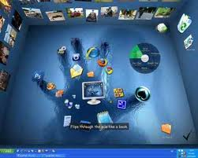

What Cannot be Accelerated?
Encrypted traffic
  SSL, IPSec
Compressed traffic
  Gzip, RAR, 7-zip, bzip
  Video, Audio
Virtual Desktop solutions
  RDP, Citrix
Non-repeating traffic
  Single file in one direction sent once
  Single web page access
What does not repeat can not be cached and accelerated!
Notes:
While the WXA Series can accelerate many applications, it’s important to note there are some types of applications it cannot. These include:
Traffic encrypted using SSL or IPSec
Traffic that has been compressed using file compression software as well as video and audio files that have built-in compression
Desktop virtualization solutions such as RDP and Citrix
And any traffic that is non-repeating
The rule of thumb to remember is, “What does not repeat cannot be cached and accelerated.”

Slide 11
Dell SonicWALL WAN Acceleration Overview
The Benefits of WAN Acceleration
Notes:
Seeing is believing, and many customers want to see the benefits of WAN Acceleration firsthand before they purchase. Let’s take a closer look.

Slide 12
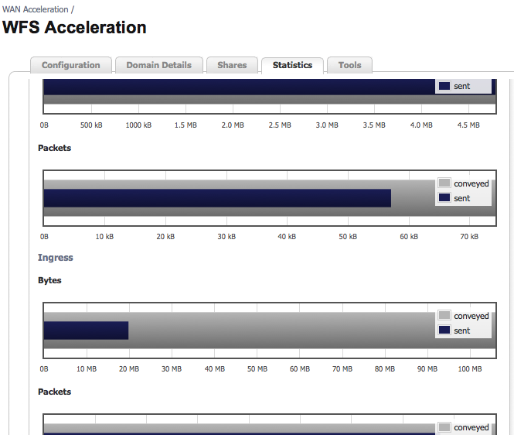
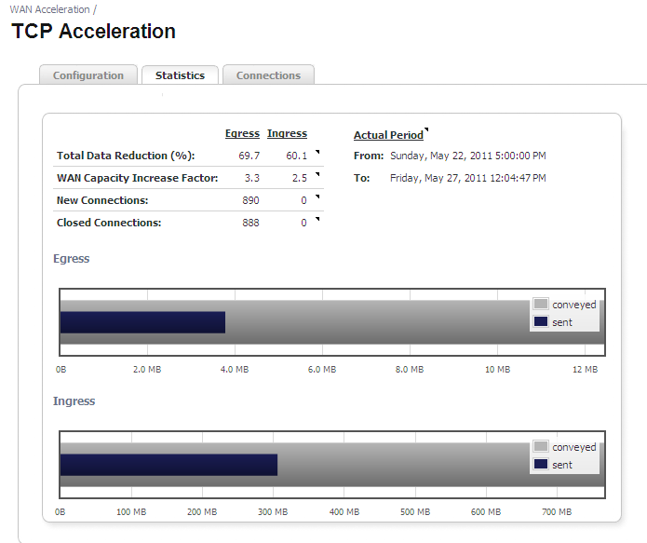
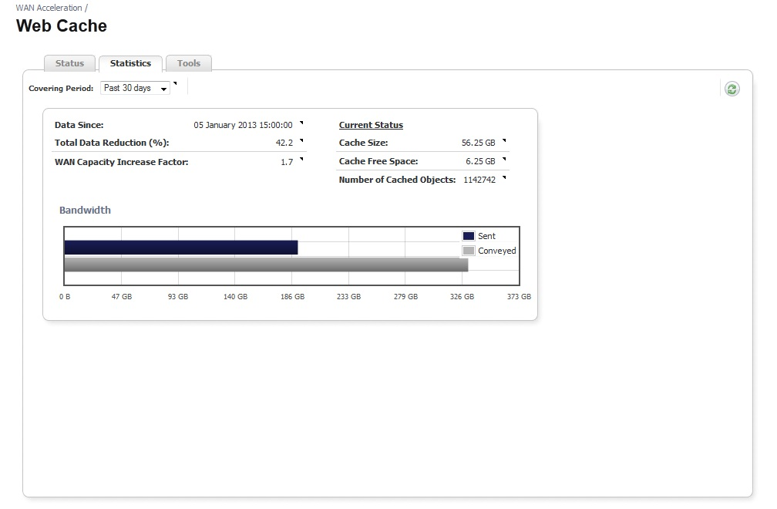
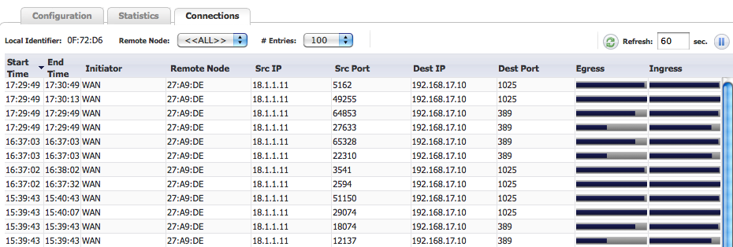
Demonstrating and Quantifying the Benefits of WAN Acceleration
Visualizing the benefits of using WAN Acceleration
Notes:
Demonstrating packet acceleration into and out of the WXA solution is simple using the built-in visualization capabilities. You can easily provide statistics detailing traffic reduction, the increase in WAN capacity and more in a variety of formats. Visualization is a powerful tool for showing exactly how the WXA Series can improve the performance of WAN applications.

Slide 13
Technical and Feature Specs
Feature | WXA 500 Software | WXA 2000 | WXA 4000 | WXA 5000 Virtual Appl. | WXA 6000 Software
Minimum SonicOS Version | SonicOS 5.8.1.11 | SonicOS 5.8.1.11 | SonicOS 5.8.1.11 | SonicOS 5.8.1.11 | SonicOS 5.8.1.14
Platform | Software | Hardware | Hardware | Virtual Appliance | Software
Recommended Concurrent Users¹ | 20 | 120 | 240 | 360 | 2,000
Maximum WAN Acceleration Connections | 100 | 600 | 1,200 | 1,800 | 10,000
Byte Caching | Yes | Yes | Yes | Yes | Yes
Web (HTTP) Caching | Yes | Yes | Yes | Yes | Yes
TCP Acceleration | Yes | Yes | Yes | Yes | Yes
Compression | Yes | Yes | Yes | Yes | Yes
CIFS/SMB Acceleration | Yes² | Yes | Yes | Yes | Yes
Signed SMB Support | Yes | Yes | Yes | Yes | Yes
WXAC Client | Yes³ | Yes³ | Yes³ | Yes³ | Yes³
Visualization | TCP/WFS/Cache | TCP/WFS/Cache | TCP/WFS/Cache | TCP/WFS/Cache | TCP/WFS/Cache
1Maximum users may vary and will depend on the number of connections generated per user. SonicWALL determines the recommended users based on 5 connections per user.
2CIFS/SMB acceleration is available only when the Live CD image is installed on the provided hardware
3Requires SonicOS 5.9.
Notes:
Let’s review the key technical and feature specs of the Dell SonicWALL WXA Series solutions. This information is important because it will help you match the right WXA solution to fit your customers’ needs.
We’ll begin with the minimum firmware version required on the Dell SonicWALL Next-Generation Firewall to which the WXA solutions are attached. The firewalls must be running SonicOS 5.8.1 or higher
The WXA Series comes in four platforms – there is a software version, the WXA 500 Live CD, two hardware versions, the WXA 2000 and WXA 4000 and a virtual appliance, the WXA 5000
The next two features – Recommended Concurrent Users and Maximum WAN Acceleration Connections – are inter-related. It’s important to understand that each concurrent user may have more than one active WAN Acceleration connection at any time. Dell SonicWALL calculates the maximum number of connections by using an average of five flows per user. The more users your customer has, the greater the number of connections they will have, so be sure to talk with your customers about the number of concurrent users they will have.
All four Dell SonicWALL WXA solutions include the following features – byte caching, TCP acceleration, Compression and Windows File Sharing Acceleration
In addition, to show the benefits of WAN Acceleration, all four models also include visualization capabilities that show the data reduction for both TCP and Windows File Sharing.

Slide 14
Dell SonicWALL WAN Acceleration Overview
Knowledge Check
Notes:
We’ll wrap up this presentation with a few questions to test you on the material we’ve covered.

