Slide 1
Why Dell Servers
Customer-inspired design, industry-leading innovation
Notes:
This deck was designed for use by Dell Partners to share and articulate the numerous benefits of Dell servers with their end customers.
Please refer to the slide notes for important additional information to share with your customers.

Slide 2
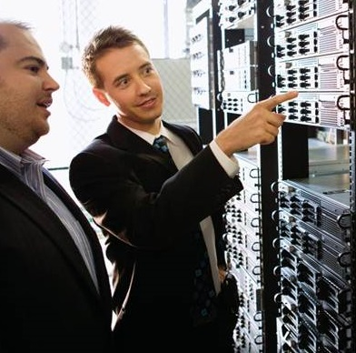
Why Dell Servers
From the smallest home offices to the largest hyperscale data centers
Dell has been in the server business for nearly 20 years.
Dell knows industry trends.
Dell understands your challenges.
Dell is a recognized industry leader with accolades including InfoWorld’s 2014 Technology of the Year (Best Server) for the Dell PowerEdge VRTX and the top spot on CRN’s all-time list for the Dell PowerEdge R720.
Dell has and will continue to innovate and evolve server infrastructures based on customer feedback.
Notes:
Thank you for your interest in learning more about the value of Dell servers.

Slide 3
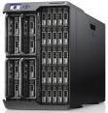
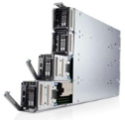
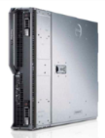
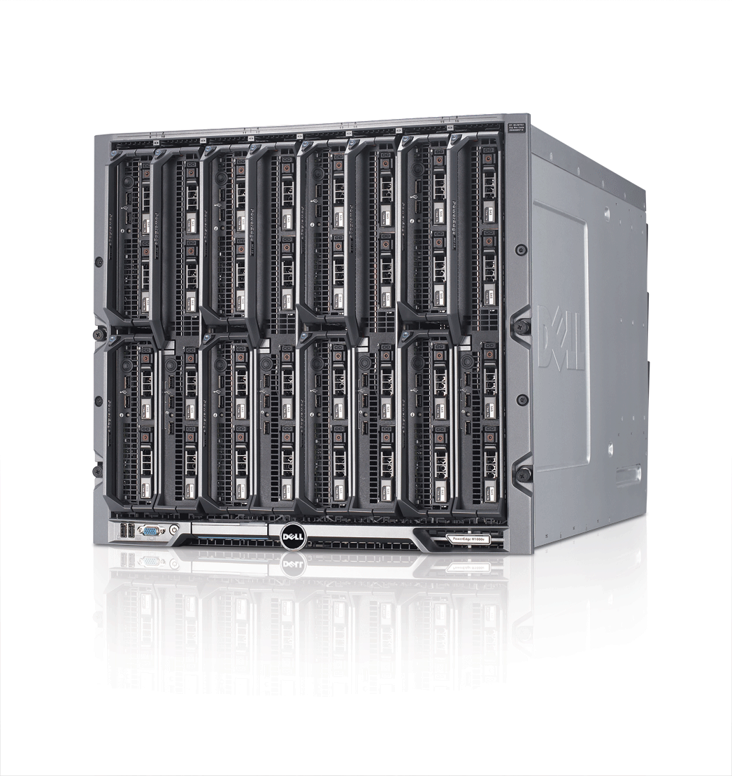
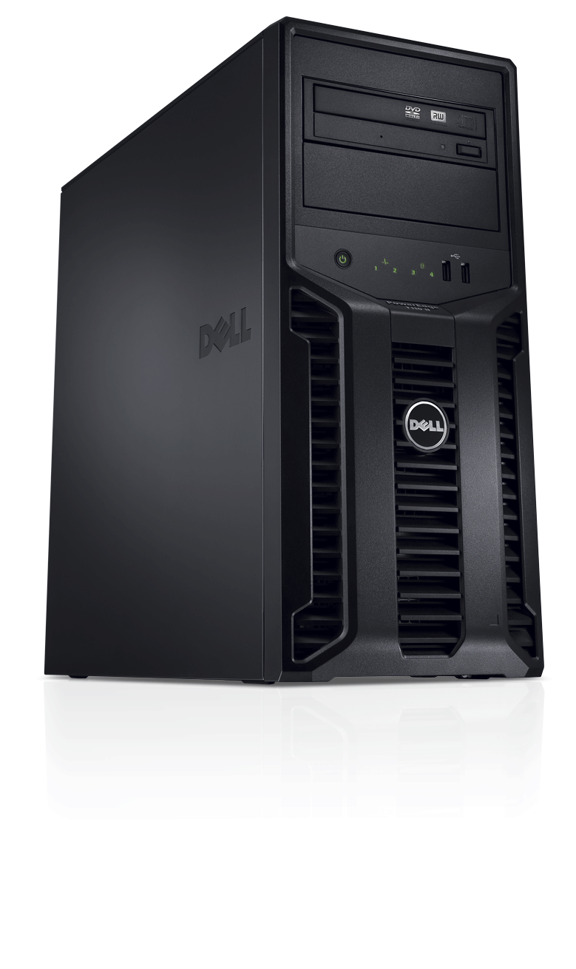
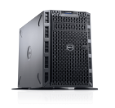
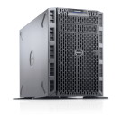
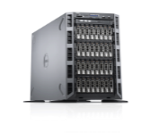
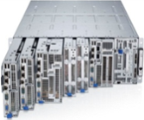
Dell PowerEdge: Server portfolio
Home office
Small business
Remote & branch offices
Small data centers
Medium to large data centers
Hyperscale¹
Shared infrastructure
PowerEdge M-Series blade servers
PowerEdge VRTX* Dense 2S/4S, storage & networking for SMB² & ROBO³
PowerEdge M420*, M520*, M620*, M820*, M915, M1000e Dense 2S to scalable 4S
PowerEdge rack-optimized servers
R210 II*
Entry 1S (1U)
R520*, R515 Mainstream 2S (2U)
R820*, R815 Dense 4S (2U)
R320* Mainstream 1S (1U)
R620* Performance 2S (1U)
R910* Highly scalable 4S (4U)
R420*, R415 Mainstream 2S (1U)
R720*, R720xd*, R715 Performance 2S (2U)
PowerEdge tower servers
PowerEdge C servers
T20*
SOHO⁴ 1S
T110 II*
Entry SMB 1S
T320* Mainstream 1S
T420* Mainstream 2S
T620* Scalable 2S
C5220*, C6015, C6145, C6220*, C8000 series* Cloud & multi-node optimized
We can work with Dell to create custom data solutions for you.
Small and medium business
Remote office/branch office
Small office/home office
*Server model powered by Intel
Notes:
Dell offers a full portfolio of PowerEdge™ servers to meet the diverse needs of all customers, regardless of your workload, from small and home offices to giant data centers. PowerEdge servers are available in tower, blade, rack and flexible installation options.
Note: Servers not identified on slide as powered by Intel use AMD processors.

Slide 4
Dell Servers Strategy
Maximize operational effectiveness
Superior customer benefit
Greater IT efficiency — Optimize costs and resource utilization for on-premises and cloud-enabled IT
Superior IT agility — Scale to meet today’s “always on, instant access” demands simply and economically
Better IT reliability — Maximize uptime to deliver results the instant they are needed
1
2
Optimize flexibility at any scale
3
Ensure worry-free computing
Notes:
Dell offers superior benefits by offering you solutions with efficiency, agility and reliability.

Slide 5
Dell PowerEdge: Differentiating features
Easy to use
Agent-free monitoring
Integrated Dell Remote Access Controller 7 (iDRAC7) with Lifecycle Controller
Power profiles
Integration with Microsoft® System Center
Best alignment with application requirements
Broad product portfolio, including blades, towers, racks and hyperscale
Top performance features, including:
Dell PowerEdge Express Flash PCIe solid-state storage device (SSD)
Split drive planar for top drive performance
Dell CacheCade™
Best uptime and cost containment
Dell Fresh Air thermals
Power-monitoring accuracy and extended power range
Redundant hypervisors (Secure Digital [SD] cards)
Memory page retire
Memory configuration error notification
Flexibility to protect IT investments
Dell PowerEdge Select Network Adapters
Switch-independent network interface card (NIC) partitioning
Notes:
Flexibility to protect IT investments
Dell’s new Select Network Adapter family — a collection of modular network interface daughter cards available on our their performance systems — lets you choose the right integrated network without using up a valuable, additional PCI slot. You can pick between multiple speeds and technology options — such as switch-independent partitioning, which allows you to share and manage bandwidth on 10GbE connections — and even upgrade the integrated network adapter later as your needs evolve.
Easy to use
Dell has streamlined and automated the most common system administrator tasks by embedding second generation systems management technology, Integrated Dell Remote Access Controller 7 (iDRAC7) with Lifecycle Controller, into the latest generation of PowerEdge servers. The Dell OpenManage™ systems management portfolio of tools simplifies managing the server lifecycle of deployment, updates, monitoring and maintenance. Using OpenManage solutions, IT administrators can manage Dell servers in physical, virtual, local and remote environments, operating in-band or out-of-band, with or without a systems management software agent.
Best alignment with application requirements
Dell PowerEdge offers a broad product portfolio, including blades, towers, racks and hyperscale configurations. With the addition of Dell Express Flash PCIe SSDs to the PowerEdge lineup — a front-accessible and hot-pluggable PCIe SSD technology — as well as increased internal storage capabilities on the new PowerEdge rack and tower servers, you now have more storage technologies, options and capacities to choose from than ever before. You can even boost RAID performance further with Dell CacheCade™, which provides the ability to use SSDs as an expanded cache for enhanced throughput.
Best uptime and cost containment
The latest PowerEdge servers also offer greater efficiency in terms of power and energy with many platforms offering class-leading or industry-leading performance per watt — every component is optimized for the most efficient operation. With Dell Fresh Air, PowerEdge servers are engineered for minimum power consumption and optimized to run at higher operating temperatures. Dell PowerEdge servers also keep your data centers running reliably with redundant failsafe hypervisors for virtualization environments, memory page retire and memory configuration error notifications.

Slide 6
PowerEdge servers: industry-leading innovation
Dell PowerEdge R720 provides the world’s best two-processor Linux® SAP® SD performance.¹
Dell PowerEdge R720 is the world’s most power-efficient server.⁴
Dell PowerEdge R720 is the world’s most power-efficient rack server.²
Dell PowerEdge M620 is the world’s most power-efficient blade server.³
Deploy virtualized infrastructure on the world’s most reliable VMware platforms, using Dell Fault Resilient Memory and redundant embedded hypervisors.⁵
Notes:
Results of the Dell PowerEdge R720 on the two-tier SAP SD standard application benchmark: 9,900 SAP SD benchmark users with the SAP enhancement package 5 for SAP ERP 6.0, Red Hat® Enterprise Linux 6.4 and Sybase® Adaptive Server Enterprise (ASE) 15.7; two Intel® Xeon® E5-2697 v2 processors (24 cores, 48 threads); and 256GB main memory. Certification number 2013031. Results of the HP® ProLiant® DL380p Gen8 on the two-tier SAP SD standard application benchmark: 9,815 SAP SD benchmark users with the SAP enhancement package 5 for SAP ERP 6.0, Red Hat Enterprise Linux 6.4, and Sybase ASE 15.7; two Intel Xeon E5-2697 v2 processors (24 cores, 48 threads); and 256 GB main memory. Certification number 2013029. Results as of October 23, 2013. For more details, visit sap.com/benchmark
Dell PowerEdge R720 achieved a SPECpower_ssj2008 result of 8,458 overall ssj_ops/watt which is higher than all published SPEC power results for rack servers as of October 2, 2013. SPEC® and the benchmark name SPECpower_ssj® are trademarks of the Standard Performance Evaluation Corporation.
A chassis full of Dell PowerEdge M620 blade servers achieves up to 25 percent higher performance/watt ratio than a chassis full of Dell PowerEdge C5220 blade servers. The 16-node Dell PowerEdge M620 achieved a SPECpower_ssj2008 result of 7,525 overall ssj_ops/watt, compared to the 16-node Dell PowerEdge C5220 with a SPECpower_ssj2008 result of 6,000 overall ssj_ops/watt score.
Dell PowerEdge R720 achieved a SPECpower_ssj2008 result of 8,458 overall ssj_ops/Watt which is higher than all published SPECpower results for rack servers as of October 2, 2013
Database performance and memory capacity with the Intel Xeon processor e5-2660 v2 powered Dell PowerEdge M620, based on Principled Technologies Test Report commissioned by Dell, July 2013. For more information, visit principledtechnologies.com/Dell/PowerEdge_E5-2600v2_FRM_0813.pdf

Slide 7
What could you do with PowerEdge servers?
Achieve more Turn your business workloads into engines for growth.
Protect your investment with a flexible IT architecture.
Access information faster for insightful decisions.
Maximize efficiency Feel confident with resilient infrastructure to maximize uptime.
Better control of energy consumption to minimize your total cost of ownership (TCO).
Ensure secure, reliable access to valuable information.
Deliver real results faster Enjoy accelerated time to value via end-to-end workload solutions.
Simplify lifecycle management of your IT infrastructure.
Automate your IT tasks to improve administrative efficiency.
Better together solutions Enjoy even greater performance when paired with Dell storage and Dell Networking solutions.

Slide 8
Where to go from here
Let’s get started!
We’re ready to work with you to design and build customized, Dell solutions that will meet your unique business needs for today—and tomorrow.
Let us know if you have additional questions about Dell PowerEdge servers or any of their end-to-end solutions.
As a Dell partner, we’re committed to helping you to:
Turn data into insights
Overcome evolving security threats and ensure compliance
Accelerate adoption: virtualization, convergence, cloud
Notes:
Thank you for your time today to learn why Dell PowerEdge servers are the right choice for you, regardless of your size or workload requirements. We look forward to helping create a customized enterprise solution based on your unique needs.

