Slide 1
Dell ProSupport Plus Channel Partner Deck
March 2014

Slide 2
Market challenge Evolving IT landscape demands enterprise-class support
Converged
Data Center
Big Data
Cloud
Virtualization
Application
Modernization
growing complexity
maintenance
costs
workload availability
multiple vendors
end user demands
The solution: Dell enterprise-class support
single point of contact
broad & deep expertise
automation
& tools
knowledge of environment
established infrastructure & scale
Notes:
The enterprise landscape is evolving with the entrance of convergence into the data centers, dealing with Big Data, moving things to the Cloud, virtualizing environments and dealing with application modernization. End users are facing a whole new set of challenges that are even more complex and difficult to handle than they’ve been in the past including: maintenance costs, workload availability, dealing with even more vendors from a hardware and software perspective, and increasing end user demands with the mobility of the workforce and the demand for always “up” applications. These challenges are driving requirements for a new level of support, a true enterprise-class support.
Enterprise-class support in our point of view means:
A single point of contact into the support organization
Broad as well as deep experience beyond the single piece of hardware
Eliminating the fact that we will have issues with automation and tools (the more we can automate these complex scenarios, the less time the end users has to deal with it, the more proactive we can be, the more we can leverage the environment we’re going to gain to drive significant enhancements and performance back to end users).
And you want all of this from a provider who has the established infrastructure and scale to deliver a consistent global experience regardless of where you’re located or what language you speak.

Slide 3
Dell ProSupport Plus Critical enterprise systems deserve more
What makes ProSupport Plus unique?
Improves hardware performance and stability proactively
Delivered by elite ProSupport Plus engineers and a dedicated Technical Account Manager (TAM)
Intelligence
Proactive recommendations
Health checks
System maintenance
What are purchase options and how is it delivered?
What makes ProSupport Plus unique?
Available on all Enterprise products except Compellent (covered by Copilot offer)
Easy to buy, no tag minimums required
Expertise
Dedicated TAM
Elite ProSupport Plus engineers
Performance & stability
What is new?
Dedicated TAM
Direct access to elite ProSupport Plus engineers
Remote monitoring and automated support with SupportAssist
Monthly contract renewal and support history reporting
Monthly health check and performance recommendations
System maintenance (as needed)
Technology
SupportAssist
Intelligence Engine
Notes:
ProSupport Plus combines:
Dell Expertise (of our dedicated technical account manager and access to our senior ProSupport engineers (who are our Level 3 support, skipping Level 1 and Level 2) who are trained on all areas of our enterprise products not just storage or server, etc resulting in a faster resolution to the problem because they won’t have to go engage other experts)
Dell Technology (SupportAssist remote monitoring that sends fault, configuration and firmware info to ProSupport engineers AND for ProSupport Plus customers only, our Intelligence Engine collects and analyzes SupportAssist information combined with quality and support trends across all of our customers to proactively improve performance by spotting trends, quality issues, areas to consolidate processing power.
Intelligence - The dedicated TAM will work with the customers to take the analysis from the Intelligence Engine and work with the customer to plan the implementation of the recommendations and in the case of firmware updates, Dell does the work for the customer.
The customer that should use ProSupport Plus is any enterprise customer that has critical systems supporting critical workloads. Every system that fits into that category should be using ProSupport Plus. Because ProSupport Plus is tag-based customers are able to determine what are those critical systems supporting critical workloads that warrant this level of proactive support.
In addition we’re looking at what customers have in their environment today. If they have ITAS or EWC or using ProSupport mission Critical combined Proactive Maintenance with they’re already seeing the benefits of components of the ProSupport Plus offer. It’s a much easier conversation with those customers to transition them up to ProSupport Plus.

Slide 4
ProSupport Plus delivery overview
Program flexibility allows partners or customers to receive deliverables*
OR
ProSupport Plus delivered to you
Available to only one entity, either you or your customer, not both
ProSupport Plus delivered to your customer
Key Benefits:
Dedicated TAM for you
Provides a single report for your multi-customer product environment. **
ProSupport Plus engineers available 24x7 for support
You may set up their customers’ SupportAssist accounts, if desired
Key Benefits:
Dedicated TAM for your customer
Provides your customer with insight into their environment through reporting
ProSupport Plus engineers available 24x7 for customer support
*SupportAssist mandatory to receive proactive reporting and system maintenance deliverables.
**IMPORTANT: When delivered to you, reports are not categorized by customer. You must manually divide reports according to your customers.
4
Notes:
This offer’s flexibility allows either you or your customers to receive deliverables. What’s important here is that these deliverables are available to either you OR your customer, but NOT both.
You receive a dedicated TAM, who will provide a single report for your multi-customer environment. Please note that when the reporting is delivered to you, it will not be categorized by customer. Partners must manually divide reports according to their customer, which the TAM can provide guidance on. You also have access to ProSupport Plus elite engineers 24x7 so they can tackle issues immediately.
Should customers choose to take advantage of this offer, they would receive a dedicated TAM with reporting and access to elite engineers around the clock.
Finally, don’t forget that SupportAssist is MANDATORY to receive reporting and system maintenance deliverables from the TAMs.

Slide 5
ProSupport Plus advantage
Upsell to ProSupport Plus to take advantage of dedicated TAM, reporting, health checks, and more.
Basic
ProSupport
ProSupport Plus
9x5
24x7
24x7
Technical support access
NBD
NBD or Mission Critical
NBD or Mission Critical
Parts and labor response



TechDirect online cases and dispatch



SupportAssist remote monitoring


Dispatch monitoring and crisis management


Escalation management


Hypervisor and OS support


Collaborative 3rd party assistance


SupportAssist automated support

Direct access to elite ProSupport Plus engineers

Dedicated Technical Account Manager

Monthly health check and performance recommendations

Monthly contract renewal and support history reporting

System maintenance
Notes:
This is how it stacks up against other ProSupport offers in our portfolio. You’ll see in the yellow column here that ProSupport Plus offering includes:
Direct access to those senior ProSupport engineers and a dedicated Technical Account Manager.
The rest of features are really there around the reporting and recommendations that that Technical Account Manager will deliver monthly.
It includes performance recommendations, health checks, they talk about things like firmware, it’s also going to show things like assets that are about to expire or assets on a different level of service. By selling this service, you can have a great APOS opportunity because you’re going to make sure that your accounts never expire and that they have the highest level of support that the customers need.
Remember that only one entity, you OR your customer, can receive these benefits.

Slide 6
Five critical components of ProSupport Plus
Dedicated Technical Account Manager
1
Your #1 support advocate at Dell, ensuring you have someone who knows you and your business.
Trusted advisor for support planning and technology decisions.
Leverages data collected by SupportAssist to improve performance and stability with proactive, personalized recommendations.
Serves as single point of contact for account management, escalation resolution and monthly reporting reviews.
Direct access to elite ProSupport Plus engineers
2
Remote monitoring and automated support with SupportAssist
3
Monthly reporting and performance recommendations
4
“I have been in this industry for 15 years and worked with almost every technology provider. The level of support we receive from Dell is really impressive. They really take care of us.”
- Dlip Patil, Yash Raj Films, India
System maintenance
5

Slide 7
Your Dell Technical Account Manager
Insert TAM
PIC
Your TAM is your #1 advocate, your single point of contact, and someone who understands your business and will help you improve the performance and stability of your customers’ environments.
Delivery of monthly reporting reviews
Delivery of performance recommendations:
Health checks and system maintenance
Contract renewal and service history reporting
Assistance with support service delivery planning
Escalation and crisis management
Trusted advisor on technology decisions
TAM Name
Technical Account Manager
<tam email>@dell.com
(tel)
(m)

Slide 8
Five critical components of ProSupport Plus
Dedicated Technical Account Manager
1
Immediate advanced troubleshooting from an elite ProSupport Plus engineer to reduce downtime and lost productivity.
Deep and broad expertise across the full breadth of Dell enterprise products to enable comprehensive issue resolution.
Utilizes information collected through SupportAssist technology to gain visibility into the issue as well as configuration and diagnostic data.
Direct access to elite ProSupport Plus engineers
2
Remote monitoring and automated support with SupportAssist
3
Monthly reporting and performance recommendations
“Dell ProSupport has been absolutely amazing. All we have to do is pick up the phone, and they get us back on track.”
- Sean Barnes, Forum Energy Technologies, United States
4
System maintenance
5

Slide 9
Five critical components of ProSupport Plus
Dedicated Technical Account Manager
1
Remotely monitors enterprise systems through leading system management consoles.
Accelerates resolution with notifications, automated case creation and proactive response.
Improves productivity by reducing time spent resolving issues.
Collects configuration information from your environment to identify critical patches and updates.
Analyzes information across entire Dell customer base, to identify trends and best practices.
Direct access to elite ProSupport Plus engineers
2
Remote monitoring and automated support with SupportAssist
3
Monthly reporting and performance recommendations
4
“The support from Dell is very good…..We don’t have to wait for anything; we ask for something, we get it.”
- Vinay Shetty, Nilkamal Limited, Japan
System maintenance
5

Slide 10
Five critical components of ProSupport Plus
Dedicated Technical Account Manager
1
Monthly health checks enabled through SupportAssist provide critical updates and performance recommendations.
Monthly contract and support history reporting to aid in budgeting and planning.
Recommendations based on trends and best practices across the Dell customer base.
The full ProSupport Plus reporting suite is available only with the implementation of SupportAssist.
Direct access to elite ProSupport Plus engineers
2
Remote monitoring and automated support with SupportAssist
3
Monthly reporting and performance recommendations
4
“We have become accustomed to the level of service provided by Dell and we no longer consider other vendors when we want to roll-out a new solution.”
- Hemant Darji, Gujarat Apollo Industries, India
System maintenance
5

Slide 11
Five critical components of ProSupport Plus
Dedicated Technical Account Manager
1
System maintenance is delivered as needed based on monthly reporting and performance recommendations.
Flexible scheduling of service delivery – available 24x7.
Service is delivered based on your available maintenance window.
Direct access to elite ProSupport Plus engineers
2
Proactive monitoring and resolution through Dell SupportAssist
3
Reduce hassles by 20%
Customers with Dell Proactive Maintenance Service report up to 20% less hardware issues than customers who do not have the service.*
Monthly reporting and performance recommendations
4
System maintenance
5
*Based on a Dell internal analysis completed on January 14, 2013 of the average number of issues customers reported during a 26 week period after having a Dell/EQL Maintenance Service performed vs. those customers without Dell/EQL Maintenance Service performed.

Slide 12
Dell SupportAssist overview
What is it?
What does it do?
How is it delivered?
SupportAssist technology, combined with leading system management consoles, enables remote monitoring of hardware environments, automatic data and log collection, proactive notifications and case creation
Management consoles include: OpenManage Essentials (OME), Microsoft System Center Operations Manager (SCOM) and EqualLogic SAN HQ
How do I get started
Decreases time spent troubleshooting and accelerates time to resolution
Provides an enhanced support experience for customers
As a standalone application for Microsoft SCOM
Integrated with OpenManage Essentials and EqualLogic SAN HQ
For downloads per console brand, go to Dell.com/SupportAssist or the Community Group page
Notes:
This gives a brief overview of Dell SupportAssist, which is critical to ProSupport Plus. Don’t forget that SupportAssist is mandatory in order to receive reporting and system maintenance.
More information is available on dell.com/supportassist, should you need it.

Slide 13
Traditional support vs. SupportAssist
“I’ve never experienced better IT support than from Dell. It’s also truly proactive, anticipating problems and dealing with them before they occur.”
- John Billington, Hugh Baird College, United Kingdom
Traditional customer/partner experience Multiple manual steps
Fault
occurs
Contact
Dell
Verify entitlement
Transport
data
Open
case
Trouble-shooting
Issue
identified
Find phone number
Customer/part-ner provides details
Upload diag data to Dell
Customer/par-ner provides details
Phone and
email exchange
Customer
SupportAssist customer/partner experience Streamlined path to resolution
Fault occurs
Automatic case creation and diag data transport
Troubleshooting
Detected through SupportAssist
Dell contacts customer/partner
after reviewing data
Customer
Notes:
SupportAssist is the underlying technology that enables the ProSupport Plus experience. Before we delve into how SupportAssist works let’s look at the traditional methods our customers were using before we introduced it.
The customer will have a fault in their environment
They’ll either monitor or maybe they won’t even find the fault until some end user calls them and says something’s down.
At that point they’ll have to figure out the contact information.
They’ll contact Dell and navigate the call director or phone menus.
They finally get to a tech support agent, they’ll talk to them and verify entitlement.
And then almost always tech support will say, “Can you send me some Log data>”
The customers will do that. If they haven’t done that, often tech support will ask them to hang up, run the diag, and call back.
At that point, the case will be open and the tech support agent will typically study the log data and then begin the troubleshooting process.
With SupportAssist that experience is radically different:
We are actively monitoring those assets in the customer’s environment.
If something occurs, we know about it. We automatically begin the process of log collection; we automatically open the case.
Tech support studies the log and case details and puts an outbound Call to the customer.
Think about that, instead of the customer having to find the number and call into Dell reactively, we’re actually able to target and have the right expert call out to that customer. That expert will have already studied the log data, and it can be as simple as, “I noticed you had a hardware failure, this is the address we have on record,
is that where you want us to send the drive?”
Dramatically different support experience that what you have in the traditional break/fix world.
All of this is enabled by SupportAssist.
Emphasize the time spent on the phone with Dell; finding out about issues too late; manually generating cases/trouble ticket (with errors) and transporting data. The manual routine is lengthy and could turn costly if detection and resolution is delayed.

Slide 14
Improve
Productivity by reducing time spent resolving issues
Case accuracy and eliminate errors with automatic case creation
Accelerate
Identification of issues with auto-email alerts from Dell at time of hardware fault
Time to resolution by accessing incident information 24x7x365
Gain
Additional insight and control of hardware environment
An enhanced support experience by reducing support steps
Dell SupportAssist customer/partner benefits
14

Slide 15
ProSupport Plus proactive reporting Sample reports
Sample Firmware Recommendations Report
Without SupportAssist
With SupportAssist
General Environment Reporting
Business hours
Install base overview product, entitlement and expiration


Incidents by rate, age and product (overview)


Dispatches by rate, age and product (overview)


Detailed case/incident review

Firmware and software revision recommendations

Utilization
Sample Configuration Overview Report
Storage enclosure overview summary
Host Name | Service Tag | Model | Name | Ctr ID | State | Connectors | Array Disks
Dallas
Host_1 | 1YZD6DS | PowerEdge R610 | PERC H200 Integrated | 0 | Ready | 2 | 1 x 279 GB
Host_2 | 6PF84DS | PowerEdge R410 | PERC 6/I Adapter | 0 | Degraded | 2 | 3 x 931 GB
Chicago
Host_3 | 10CNLD1 | PowerEdge R620 | PERC 6/I Integrated | 0 | Ready | 2 | 4 x 148.5 GB
Host_4 | FHSGVDX | PowerEdge R510 | PERC H700 Integrated | 0 | Ready | 2 | 12 x 1.9 TB
Host_4 | FHSGVDX | PowerEdge R510 | PERC H700 Integrated | 1 | Ready | 2 | 2 x 279 GB

Overall volume capacity and utilization

In-depth capacity review


Page pool configuration
IMPORTANT! When delivered to partner, reports are not categorized by customer. Partners must manually divide reports according their customer.
15
Notes:
One of the other things that SupportAssist is able to do is offer comprehensive reporting. This reporting will be delivered monthly to either the partner or the customer. This chart shows the comparison of reporting we deliver today with existing services such as IT Advisory Services or Enterprise Wide Contract. It’s really historical data based on case data.
With ProSupport Plus we add a lot more. In addition to having that service history reporting, we’ll also make recommendations around firmware and software revisions and also utilization recommendations around how much storage is left in your array, volume and capacity, and in-depth information around performance of those arrays and products in their storage space. It’s a deep, deep level of reporting that comes with ProSupport Plus. On a monthly basis we want to deliver on that promise of performance and stability to partners or customers.
Additional information below that’s good to know:
Based on the requirements from ProSupport Plus, these are a series of named reports designed to meet those requirements. These reports will be available at 3 levels:
Chart summary, suitable for inclusion in customer-facing Executive Summary section and TAM dashboard (internal only)
Summary reports for system, various storage classes & network devices ←these will be assembled into the report set, along with recommendations
Detailed reports will be available to the TAM & tech support agents at the reporting dashboard to obtain detailed information about systems. These can be used to obtain details on assets that need to be upgraded, investigated for predicted failures, etc.
The reports at launch will be pulled/organized by the TAM for the partner or customer and presented in a consolidated report. The report “set” are made up of the following individual reports:
Firmware Revisions - Firmware and Software Versions by asset (w/ recommendations for critical upgrades)
System Configuration - Detailed, as-maintained system configuration
System Summary Report - Summary of System Configuration, derived from System Configuration detail
Firmware Detail Report - Breakdown showing all upgradeable firmware and driver components, derived from Firmware Revisions detail
Firmware Summary Report - Firmware and Software Versions by asset (w/ recommendations for critical upgrades), derived from Firmware Revisions detail
Direct Attached Storage Report - Summary of Direct Attached Storage, derived from Direct Attached detail
Disk Drive Details - Drill down to drives in Direct Attached Storage
EQL Array - Provides detailed information about EQL Storage Arrays
EQL Storage Report - Summary Report on EQL Storage Devices, derived from EQL Array detail
MD Storage - Provides detailed information about MD Series Storage Devices
Network Switches - Provides information about PowerConnect network switches

Slide 16
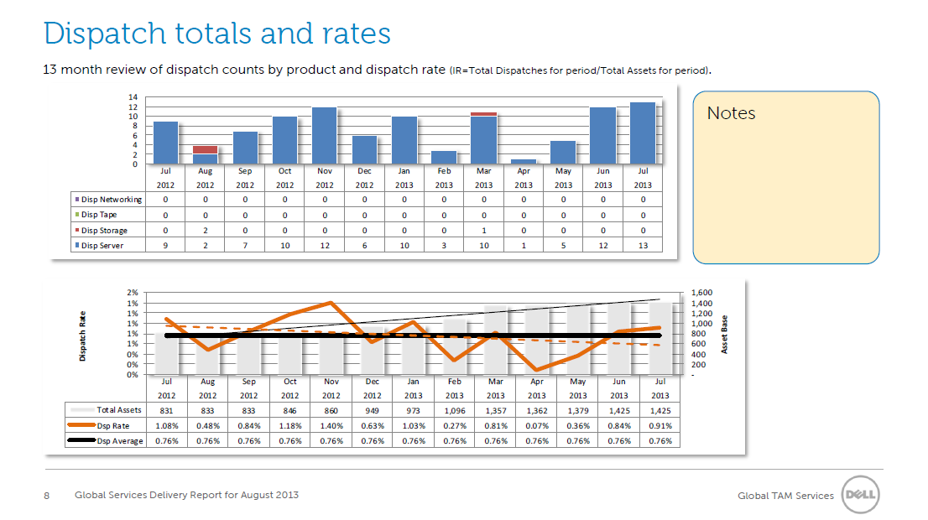
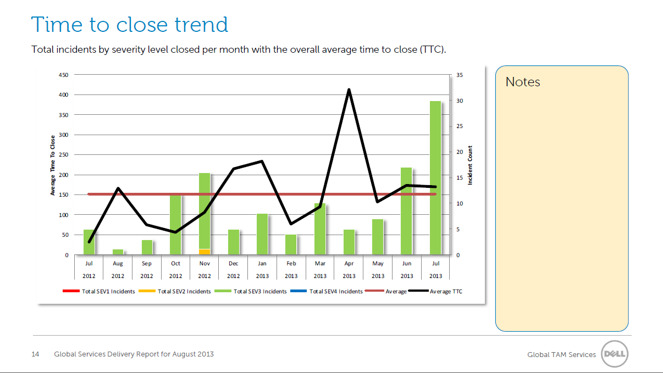
ProSupport Plus proactive reporting Additional report examples
In order to receive system-specific reporting, you must install SupportAssist
When delivered to you, reports are not categorized by customer. You must manually divide reports according to your customer.
Reporting available to only one entity, either to you or your customer, not both
16
Notes:
Here are more sample reports. Please note that you and customers must install SupportAssist to receive system-specific reporting. When delivered to you, reports are not categorized by customer. You must manually divide reports according to their customer.
Finally, please remember that reporting is available to one entity, either the partner or the customer, but not both.

Slide 17
Technical training

Slide 18
Dell SupportAssist
Feature comparison by service offer
Feature | Hardware & Basic | ProSupport | ProSupport Plus
Remote monitoring Monitoring of end user hardware to provide critical alerts through automated or console notifications
Automated log & configuration collection Information required for troubleshooting the issue is automatically collected and sent to Dell
Automatic support case creation After a critical alert is received, information is sent to Dell and the service request is automatically created. Support agent contacts customer or partner after
Parts dispatch If part needs to be replaced in the end users’ environment, a replacement part will be dispatched
Enables Reporting & Insight (*) The designated TAM will leverage rich data coming out of SupportAssist and provide insights, backed up by automated reporting
Enables Maintenance (*) An understanding of the end users’ environment, patch levels, historical issues and performance drive more efficient maintenance
(*) Only ProSupport Plus customers will benefit from the Intelligence Engine via their TAM. It collects and analyzes SupportAssist information combined with quality and support trends across all of our customers to proactively improve performance by spotting trends, quality issues, areas to consolidate processing power.
18

Slide 19
SupportAssist integration in Dell systems
SupportAssist provides 24x7 system monitoring, automatic data collection, detection of issues and notifications alerting you about an identified issue.
Data is securely transported to Dell or you as the service partner, a case is created, and a technical specialist calls you or your customer directly to resolve the issues, which saves time and costly outcomes.
Hardware devices
servers | storage | network
Systems Management consoles
CRM integration
Intelligence engine
Proactive recommendations
& reporting

Notes:
How does Dell technology enable this proactive and preventative support – with SupportAssist. Our newest tool, integrated
into OpenManage Essentials (OME), provides 24/7 system monitoring, automatic data collection, detection of issues and notifications alerting you about an identified issue. From there, data is securely transported to Dell, a case is created and a technical specialist calls you directly to resolve the issues….saving you time and costly outcomes. Also available on EqualLogic storage through SAN Headquarters.
As mentioned in the previous slide – we’re taking it one step further, by leveraging data gathered across our customer environments to provide personalized reporting and optimization for proactive and predictive support.

Slide 20
SupportAssist requirements for OME
Supported systems
9G-12G PowerEdge servers running the following Operating system:
- Windows
- Linux
- ESX/ESXi
PowerVault Storage (MD,NX,DL)
PowerConnect Switches
EqualLogic Arrays
F10
Prerequisites
OpenManage Essentials (OME)
SNMP configured on monitored devices to send Traps to OME
ProSupport entitlement on monitored devices
For a full list of supported systems

Slide 21
SupportAssist requirements for MS SCOM
Supported Dell Server systems
SupportAssist can monitor 9G-12G PowerEdge servers (includes VRTX) running the Windows server 2003 , 2008 or 2012 operating systems
For a full list of supported Dell Server systems
Prerequisites
Microsoft System Center Operations Manager 2007 or 2012 on Windows Server 2008
Dell Server Management Pack Suite configured to monitor PowerEdge Servers
SupportAssist for Microsoft SCOM
ProSupport entitlement on monitored devices

Slide 22
Get started with Dell SupportAssist
To learn more and get started, see SupportAssist Community Group
User Guide, Quick Start Guide, Supported Products matrix
Video tutorials
Frequently Asked Questions (FAQs)
Forum and blog for peer-to-peer chat
Refer to the table below for more information:
Environment | Systems Management Consoles | Download
Dell Enterprise: PowerEdge PowerVault PowerConnect Force10 | OME | Download OME with SupportAssist bundle If you already have OME and need SupportAssist stand alone OME download now.
Dell Storage: EqualLogic | SAN HQ | Go into the SAN HQ console and click on SupportAssist within configurator; SAN HQ User Guide has more detail
Dell Servers: PowerEdge | Microsoft (SCOM) Systems Center Operations Manager | 1. Download Dell Server Management Pack Suite v5.1 for SCOM | 2. Download SupportAssist for Microsoft SCOM

Slide 23
Resources

Slide 24
Dell ProSupport Plus global availability
Response options
Next Business Day
Mission Critical Response times (2/4/8 HR)
Americas
Dell
EMEA
Dell
EMEA
Partner enabled
APJ
Dell
APJ
Partner enabled
United States
Canada
Latin America:
Antigua & Barbuda
Argentina
Aruba
Bahamas
Barbados
Bermuda
Bolivia
Brazil
British Virgin Islands
Cayman Islands
Chile
Columbia
Costa Rica
Dominican Republic
Ecuador
El Salvador
French West Indies
Grenada
Guatemala
Guyana
Honduras
Jamaica
Mexico
Nicaragua
Panama
Paraguay
Peru
Puerto Rico
Suriname
Trinidad & Tobago
US Virgin Islands
Uruguay
Venezuela
Austria
Belgium
Czech Rep
Denmark
Finland
France
Germany
Greece
Ireland
Italy
Luxembourg
Monaco
Netherlands
Norway
Poland
Portugal
Slovakia
South Africa
Spain
Sweden
Switzerland
United Kingdom
Vatican City
Angola
Bahrain
Bulgaria
Croatia
Egypt
Estonia
Ghana
Hungary
Israel
Jordan
Kazakhstan
Kenya
Kuwait
Latvia
Lithuania
Morocco
Nigeria
Oman
Qatar
Romania
Russia
Saudi Arabia
Serbia
Slovenia
Tanzania
Tunisia
Turkey
Ukraine
United Arab Emirates
Australia
China
Hong Kong
India
Japan
Macau
Malaysia
New Zealand
Singapore
South Korea
Taiwan
Thailand
Brunei
Indonesia
Philippines
Vietnam
Availability and terms of Dell Services vary by region. For more information, visit www.dell.com/servicedescriptions.
For Partner-Distributed Countries please contact your Dell representative for the Optional Services beyond Dell ProSupport Core Service Models Remote Diagnosis is determination by online/phone technician of cause of issue; may involve customer access to inside of system and multiple or extended sessions. If issue is covered by Limited Hardware Warranty and not resolved remotely, technician and/or part will be dispatched, usually within 1 business day following completion of Remote Diagnosis. Availability varies. Other conditions apply.

Slide 25
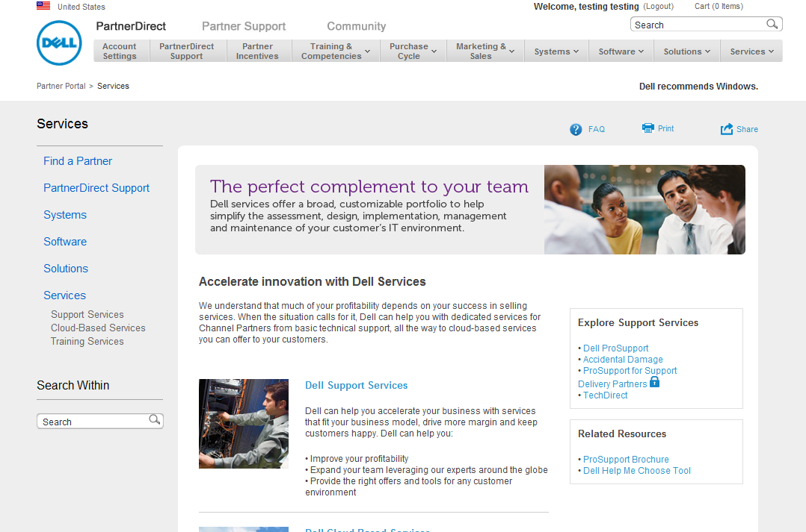
PartnerDirect
Available collateral:
ProSupport Plus partner deck
ProSupport Plus customer deck
ProSupport Plus data sheet
Partners should access the PartnerDirect portal to learn more about Dell Services, access collateral, and find solutions

Slide 26
Why Dell?
Smarter strategies for smarter support.
A strategy that allows you to help your customers to fearlessly adopt new technology and gives them freedom to focus on their business. Having the same enterprise-class support from Dell across the infrastructure gives you and your customers freedom to focus on what matters most.
As managing technology gets harder, Dell support is getting smarter.
26
Global Support and Deployment

Slide 27
Thank you
27
Notes:
Thank you for taking the time to attend this training. Again, if you have any questions about ProSupport Plus, please don’t hesitate to let us know. We are here to help you be successful in selling ProSupport Plus.

